Slide 1
Oncology NURSING
CYRUS KING B. CAYAGO, RN, USRN, MAN, DPT, BCG, OPV

Slide 2
TRUE OR FALSE
1. Today more than half of all people diagnosed with cancer can cured.
2. There are warning signs with cancer; illness tends to come on suddenly
3. Most cancers are hereditary.
4. Standard cancer treatment includes surgery, radiation, and chemotherapy.
5. People undergoing cancer treatment have fewer side effects when they eat a well-balanced diet.

Slide 3
TRUE OR FALSE
6. HPV, a virus that can cause cancer, is contagious.
7. Men cannot develop breast cancer.
8. Chemotherapy is not the only treatment method for cancer.
9. During chemotherapy, everyone loses their hair.
10. A positive attitude can help cure cancer.

Slide 4
Objectives
Compare the structure and function of the normal and cancer cells.
Differentiate between benign and malignant tumors.
Identify agents and factors that are carcinogenic.
Describe the significance of health education and preventive care in decreasing the incidence of cancer.
Differentiate among the purpose of surgical procedures used in cancer treatment, diagnosis, prophylaxis, palliation, and reconstruction.

Slide 5
Objectives
Describe the concept of hospice in providing care for patients with advanced cancer.
Identify assessment parameters and nursing management of patients with oncologic emergencies

Slide 6
Objectives
Describe the roles of surgery, radiation therapy, chemotherapy, targeted therapy, hematopoietic stem cell transplantation, and other therapies in treating cancer.
Describe the special nursing needs of the patients receiving chemotherapy.
Describe nursing care related to common nursing diagnoses associated with cancer: impaired skin integrity, alopecia, nutritional problems, and altered body image.
Identify potential complications for the patient with cancer and discuss associated nursing care.

Slide 7
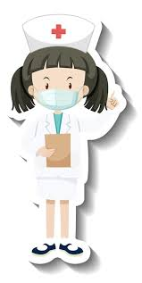
What is cancer?
Cancer is a disease process that begins when an abnormal cell is transformed by genetic mutation of the cellular DNA.

Slide 8
What is oncology?
Branch of medicine that deals with the study, detection, treatment and management of cancer.

Slide 9
What is oncology nursing?
Branch of nursing that deals with the study, detection, treatment, and management of cancer and neoplasia.

Slide 10
Proliferative patterns
Atrophy
Hypertrophy
Hyperplasia
Metaplasia
Dysplasia
Anaplasia
Neoplasia

Slide 11
Cancer terminologies
Neo = New
Plasia = Growth
Plasm= Substance
Trophy = Size
Oma = Tumor
A = None
Ana = Lack
Hyper = Excessive
Meta = Change
Dys = Bad / Impaired

Slide 12
Cancer terminologies
Atrophy
Hypertrophy
Hyperplasia
Metaplasia
Dysplasia
Anaplasia
Neoplasia

Slide 13
Cancer terminologies
Epithelial Tissues (Carcinoma)
Glandular Tissues ( Adenocarcinoma)
Connective, Muscle and Bone Tissue ( Sarcoma )
Brain and Spinal Cord Tissues ( Glioma )
Pigmented Cells ( Melanoma )
Plasma ( Myeloma )
Lymphatic tissue ( Lymphoma )
Leukocytes ( Leukemia )
Erythrocyte ( Erythroleukemia)

Slide 14
Proliferative patterns
BENIGN
MALIGNANT

Slide 15
BENIGN
Cell Characteristics
  Well-differentiated cells that resemble normal cells of the tissue from which the tumor originated.
Mode of Growth
  Tumor grows the expansion and does not infiltrate the surrounding tissues; usually encapsulated
Rate of growth
  Rate of growth is usually slow

Slide 16
BENIGN
Metastasis
  Does not spread by metastasis
General Effects
  Is usually a localized phenomenon that does not cause generalized effects unless its location interferes with vital functions.
Tissues Destruction
  Does not usually cause tissue damage unless its location interferes with blood flow.

Slide 17
BENIGN
Ability to Cause Death
  Does not usually cause death unless its location interferes with vital function.

Slide 18
Malignant
Cell Characteristics
  Cells are undifferentiated and often bear little resemblance to the normal cells of the tissue from which they arose.
Mode of Growth
  Grows at the periphery and sends out processes that infiltrate and destroy the surrounding tissues.
Rate of growth
  Rate of growth is variable and depends on the level of differentiation; the more anaplastic the tumor, the faster its growth.

Slide 19
Malignant
Metastasis
  Gains access to the blood and lymphatic channel and metastasizes to other areas of the body
General Effects
  Often causes generalized effects, such as anemia, weakness, and weight loss
Tissues Destruction
  Often causes extensive tissue damage as the tumor outgrows its blood supply or encroaches on blood flow to the area; may also produce substances that cause cell damage

Slide 20
Malignant
Ability to Cause Death
  Usually causes death unless growth can be controlled.

Slide 21
Carcinogenesis
Three steps of Carcinogenesis
  Initiation
  Promotion
  Progression

Slide 22
etiology
Causes of Cancer?
  Viruses and Bacteria
  Physical Agents
  Chemical Agents
  Genetic Factors
  Heredity Dietary Factors
  Hormonal Factors

Slide 23
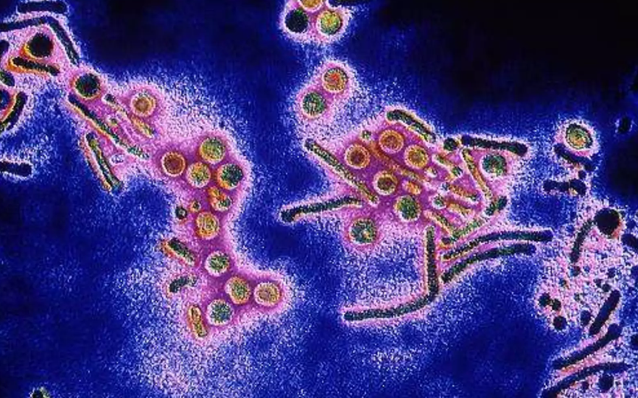
Virus and bacteria

Slide 24
Viruses and bacteria 🦠
  Some infections can trigger cancer by causing long-term inflammation or altering genes.
  HPV → cervical, throat cancers
  Hepatitis B & C → liver cancer
  Helicobacter pylori → stomach cancer

Slide 25

Physical agents

Slide 26
Physical agents ☢️
  These cause direct DNA damage.
  Ionizing radiation (X-rays, gamma rays)
  UV radiation from sunlight → skin cancer
  Asbestos → lung cancer, mesothelioma

Slide 27

Chemical agents

Slide 28
Chemical agents 🧪
  Cancer-causing chemicals (carcinogens) that damage DNA.
  Tobacco smoke (biggest preventable cause)
  Alcohol
  Industrial chemicals (benzene, dyes, pesticides)
  Air pollution

Slide 29
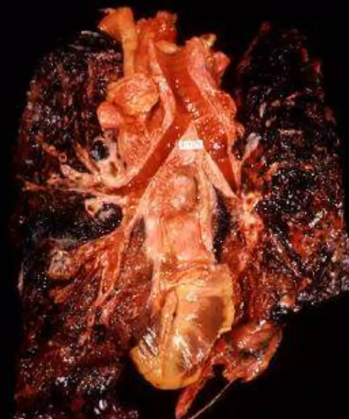
Chemical agents

Slide 30
Genetic factors 🧬
  Mutations in genes that control cell growth. These can happen randomly or after exposure to carcinogens.

Slide 31
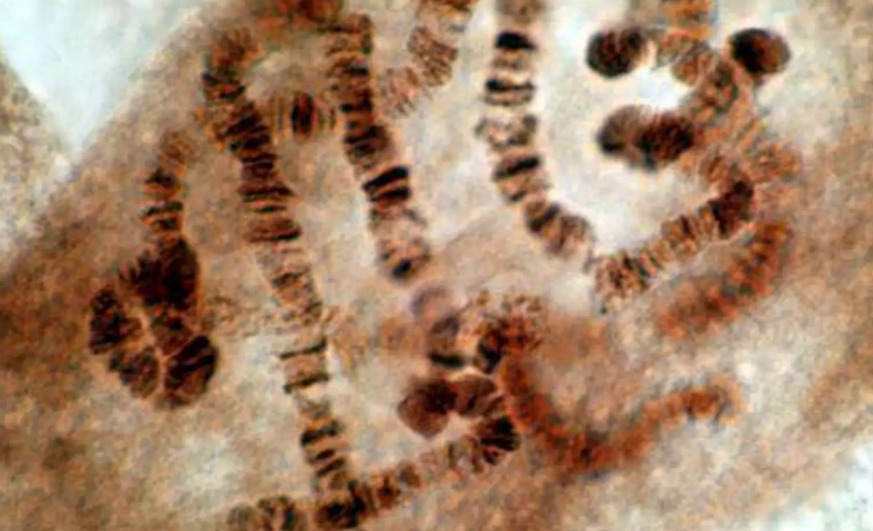
Genetics and heredity

Slide 32
Heredity 👨‍👩‍👧‍👦
  Some people inherit faulty genes that raise cancer risk (not the cancer itself).
  BRCA1/BRCA2 → breast & ovarian cancer
  Familial colon cancer syndromes

Slide 33

Dietary factors

Slide 34
Dietary factors 🍔🥦
  Diet influences cancer risk over time.
  High fat, processed foods
  Low fiber intake
  Excess red or smoked meats
  Obesity

Slide 35
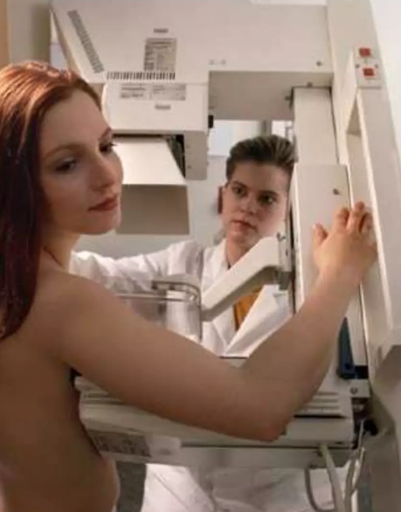
Hormonal agents

Slide 36
Hormonal factors ⚖️
  Hormones can stimulate cell growth and increase risk.
  Estrogen → breast & uterine cancer
  Testosterone → prostate cancer

Slide 37
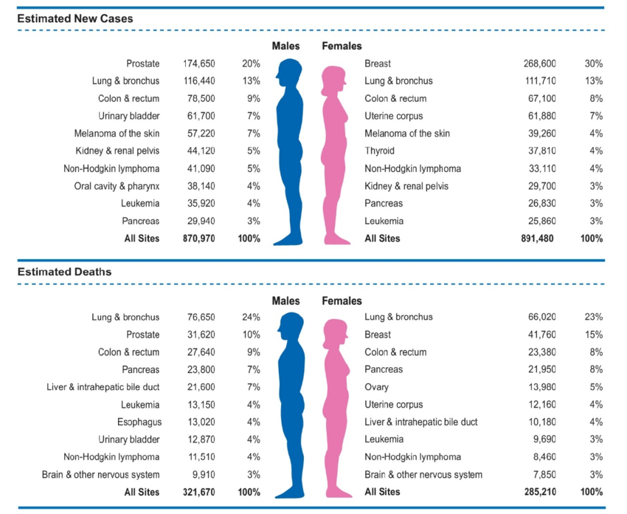
leading sites of new cancer cases and deaths 2023

Slide 38
Etiology for specific type
Breast Cancer
  Family History
  High-fat diet
  Obesity After Menopause
  Alcohol Consumption
  Postmenopausal Estrogen and Progestin
  First Child After Age 30

Slide 39
Etiology for specific type
Cervical Cancer
  Multiple Sexual Cancer
  Having Sex at an Early Age
  Exposure to Human Papilloma Virus
  Smoking

Slide 40
Etiology for specific type
Colorectal Cancer
  Family History
  Low Fiber Diet
  History of Rectal Polyps

Slide 41
Etiology for specific type
Esophageal Cancer
  Heavy Alcohol Consumption
  Smoking

Slide 42
Etiology for specific type
Lung Cancer
  Cigarette Smoking
  Asbestos, Arsenic, and Radon Exposure
  Secondhand Smoke
  TB

Slide 43
Etiology for specific type
Skin Cancer
  Excessive Exposure to UV Radiation (SUN)
  Fair Complexion
  Work with Coal, Tar, Pitch, or Creosote
  Multiple or Atypical Nevi (MALES)

Slide 44
Etiology for specific type
Stomach Cancer
  Family History
  Diet Heavy in Heavy Smoked, Pickled or Salted Foods

Slide 45
Etiology for specific type
Prostate Cancer
  Increasing of Age
  Family History
  Diet High in Animal Fat

Slide 46
Cancer grading
Grade 1 (Low grade / Well differentiated)
  Cells look almost like normal cells
  Slow-growing
  Less aggressive
  Better prognosis

Slide 47
Cancer grading
Grade 2 (Intermediate / Moderately differentiated)
  Cells look somewhat abnormal
  Moderate growth rate

Slide 48
Cancer grading
Grade 3 (High grade / Poorly differentiated)
  Cells look very abnormal
  Fast-growing
  More aggressive

Slide 49
Cancer grading
Grade 4 (Undifferentiated / Anaplastic)
  Cells look nothing like normal cells
  Very rapid growth
  Worst prognosis

Slide 50
Cancer staging
The TNM system is the most widely used method for staging cancer. It describes how big the cancer is, where it has spread, and how advanced it is.
TNM = Tumor • Nodes • Metastasis

Slide 51
T – Primary Tumor
  Describes the size and extent of the main tumor.
  T0 – No evidence of primary tumor
  Tis – Tumor in situ (early cancer, hasn’t invaded nearby tissue)
  T1–T4 – Increasing size and/or local spread
    Higher number = larger tumor / more invasion

Slide 52
N – Regional Lymph Nodes
  Shows whether cancer has spread to nearby lymph nodes.
  N0 – No lymph node involvement
  N1–N3 – Increasing number and extent of lymph nodes involved
    Higher number = more nodes affected

Slide 53
M – Distant Metastasis
  Indicates spread to distant organs.
  M0 – No distant metastasis
  M1 – Distant metastasis present (e.g., liver, lung, brain, bone)

Slide 54
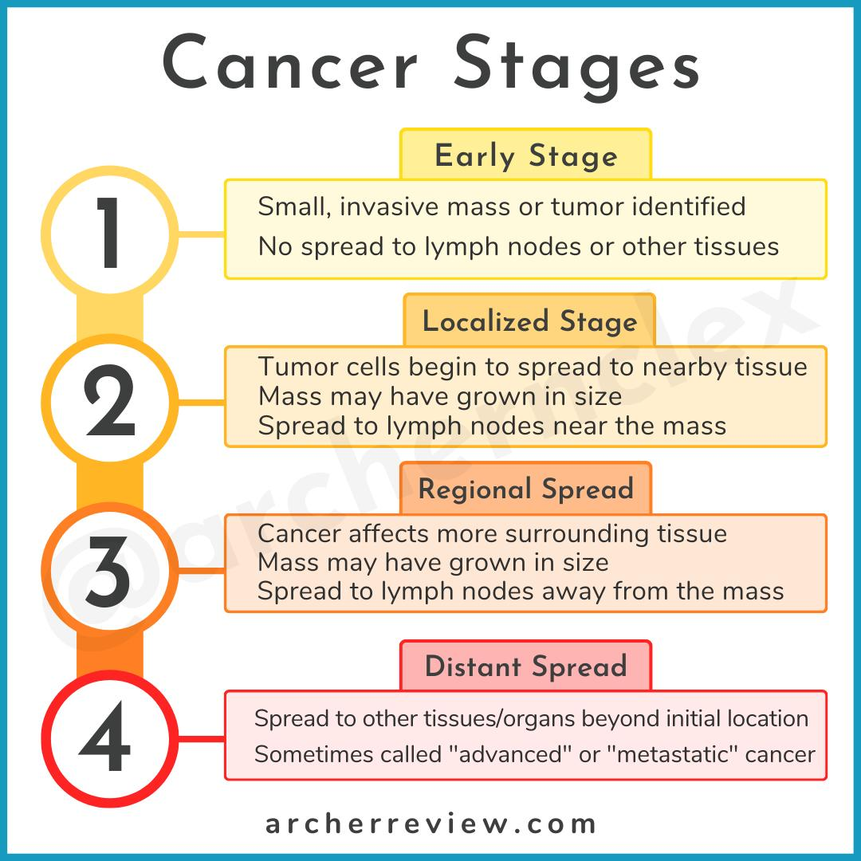
Cancer staging

Slide 55
“Prevention is a priority in oncological nursing because at least one-third of all cancers are preventable”.

Slide 56
“Cancer is also curable if detected and treated early”.

Slide 57
Cancer prevention
PRIMARY PREVENTION
SECONDARY PREVENTION

Slide 58
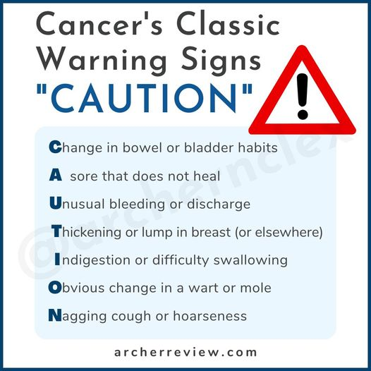
PREVENTION AND DETECTION

Slide 59
PREVENTION AND DETECTION
Promoting risk factor awareness
Promoting healthy behavior
Limiting Alcohol Consumption
Hepa B Virus Infant Vaccination
Control of STDs
Teaching skills for early detection program
Promoting participation in early detection programs

Slide 60
Acs recommendation
Maintain a healthy weight throughout life.
  Balance caloric intake with physical activity
  Avoid excessive weight gain throughout the life cycle
  Achieve and maintain a healthy weight if currently overweight or obese

Slide 61
Acs recommendation
Adopt a Physically active lifestyle.
Adults: engage in at least 30 minutes of moderate to vigorous physical activity, above usual, on 5 or more days of the week; 45-60 minutes if intentional physical activity is preferable.
Children and adolescents: engage at least 60 minutes per day of moderate to vigorous physical activity at least 5 days per week.

Slide 62
Acs recommendation
Consume a healthy diet, with an emphasis on plant sources.
  Choose food and beverages in amounts that help maintain a healthy weight.
  Eat five or more servings of a variety of vegetables and fruits each day.
  Limit consumption of processed and red meats.
  If you drink alcoholic beverages, limit consumption

Slide 63
Acs recommendation
  Detection of Breast Cancer
    Monthly BSE
    Women at the age of 40 should have a yearly mammogram and breast examination by a healthcare provider

Slide 64
Acs recommendation
  Detection of Colon Cancer
    All aged 50 and up should have a yearly fecal occult blood test
    Digital Rectal Exam and Flexible sigmoidoscopy every 5 years.
    Colonoscopy with Ba Enema every 10 Years

Slide 65
Acs recommendation
  Detection of Prostate Cancer
    Beginning age 50, yearly digital rectal examination and Prostate-specific antigen (PSA)

Slide 66
Important exam points
  PSA is organ-specific, not cancer-specific
  Raised PSA can occur in:
    Prostate cancer
    Benign prostatic hyperplasia (BPH)
    Prostatitis
    After ejaculation or prostate manipulation

Slide 67
General reference value
  ≤ 4.0 ng/mL → considered normal in adult men

Slide 68
Acs recommendation
  Detection of Uterine Cancer
    Yearly Pap-smear for sexually active females and any female over age 18
    At menopause, High-risk women should have an endometrial tissue sample.

Slide 69
Cancer screening
  BIOPSY
  Types:
  Needle
  Incisional
  Excisional
  Staging

Slide 70
Tumor markers
  ONCOFETAL ANTIGEN
  Carcinoembryonic Antigen (CEA)
  Alpha-Feto Protein

Slide 71
Raised AFP levels are seen in:
  Hepatocellular carcinoma (HCC)
  Germ cell tumors (especially yolk sac tumor, non-seminomatous testicular cancer)
  Liver diseases (cirrhosis, hepatitis – moderate rise)

Slide 72
Tumor markers
  HORMONES
ADH
Calcitonin
Catecholamines
HCG
PTH

Slide 73
Tumor markers
ISOENZYMES
Neurospecificity Enolase (NSE)
Prostatic Acid Phosphatase (PAP)

Slide 74
Tumor markers
TISSUE-SPECIFI ANTIGEN
Prostate-specific Antigen (PSA)

Slide 75
Radiation therapy
CYRUS KING B. CAYAGO, RN, USRN, MAN, DPT, HEPA B, BCG, OPV

Slide 76
RADIATION THERAPY
INTERNAL RADIATION THERAPY ( Brachy Therapy)
EXTERFNAL RADIATION THERAPY (Teletherapy)

Slide 77
brachytherapy
SOURCES
  Implanted into the affected tissue or body cavity
  Ingested as a solution
  Injected as a solution into the bloodstream or body cavity.
  Introduced through a catheter into the tumor
SIDE EFFECTS
  Fatigue
  Anorexia
  Immunosuppression

Slide 78
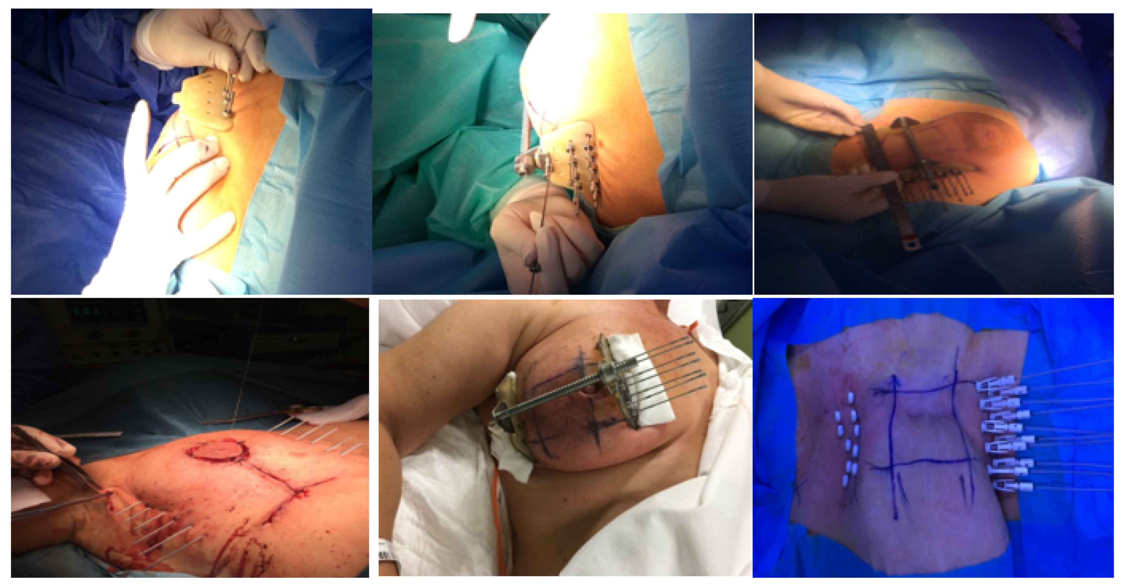
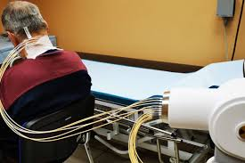
brachytherapy

Slide 79
brachytherapy
Client Education
  Avoid close contact with others until the treatment is completed
  Maintain daily activities unless contraindicated
  Rest
  Maintain a balanced diet and fluid intake
  If the implant is temporary, the client should be on bed rest
  Excreted body fluids may be radioactive; double flush the toilets after use.

Slide 80
brachytherapy
Nursing management
  Minimize time spent near the radiation sources
  Minimum distance should be 6 feet
  Use lead shields
  Place the client in a private room
  Ensure proper handling and disposal of body fluids
  Pregnant women and children are not allowed inside the client’s room.

Slide 81
teletherapy
SIDE EFFECTS
  Tissue damage to the target area
  Ulceration of oral mucous membranes
  Nausea, Vomiting, and Diarrhea
  Fatigue
  Alopecia
  Immunosuppression

Slide 82
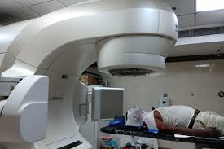
teletherapy

Slide 83
teletherapy
CLIENT EDUCATION
  Wash the marked area of the skin with plain water only and pat dry. Do not wash off the treatment site marks
  Avoid rubbing, scratching, or scrubbing the treatment site. Do not apply extreme temperatures to the treatment site. If shaving is necessary, use an electric razor.
  Wear soft, loose-fitting clothing over the treatment area
  Protect skin from sun exposure during the treatment and for at least 1 year after the treatment.
  Maintain proper rest, diet, and fluid intake
  Hair loss may occur

Slide 84
chemotherapy
CYRUS KING B. CAYAGO, RN, USRN, MAN

Slide 85
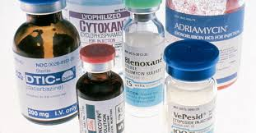
CHEMOTHERAPHY

Slide 86
How is chemotherapy used?
Sometimes, it treats cancer by itself, but more often it’s used in combination with:
  Surgery: A doctor removes cancerous tumors or tissue, or organs contaminated with cancerous cells.
  Radiation therapy: A doctor uses invisible radioactive particles to kill cancer cells. It may be delivered by a special machine that bombards parts of your body from the outside, or by putting radioactive material on, near, and even inside your body.
  Biological therapy: Living material in the form of bacteria, vaccines, or antibodies are carefully introduced to kill cancer cells.

Slide 87
How is chemotherapy used?
Chemotherapy may be used to:
  Shrink a tumor before radiation therapy or surgery -- called neoadjuvant chemotherapy
  Destroy any remaining cancer cells after surgery or radiation therapy -- called adjuvant chemotherapy
  Make other therapies (biological or radiation) more effective
  Destroy cancer cells that return or spread to other parts of your body

Slide 88
CHEMOTHERAPHY
ROUTE OF ADMINISTRATION
IV
ORAL
INTHRATECAL
TOPICAL
INTRAARTERIAL
INTRACAVITY
INTRAVESICAL

Slide 89
Chemotherapy agents
ALKYLATING AGENT
  CYCLOPHOSPHAMIDE
ANTIMETABOLITES
  5-FU (5 - FLUOROURACIL)
  METHOTREXATE
CYTOTOXIC ANTIBIOTICS
  BLEOMYCIN
  DOXORUBICIN

Slide 90
Chemotherapy agents
HORMONES AND HORMONE ANTAGONIST
  PREDNISONE
  TAMOXIFEN
PLANT ALKALOIDS
  ETOPOSIDE
L-ASPARAGINASE
  L-ASPARAGINASE

Slide 91
Chemotherapy agents
ALKYLATING AGENT
  CYCLOPHOSPHAMIDE
Alkylating agents keep the cell from reproducing (making copies of itself) by damaging its DNA
These drugs work in all phases of the cell cycle and are used to treat many different cancers
including cancers of the lung, breast, and ovary as well as leukemia, lymphoma, Hodgkin disease, multiple myeloma, and sarcoma.

Slide 92
Chemotherapy agents
ANTIMETABOLITES
  5-FU (5 - FLUOROURACIL)
  METHOTREXATE
Antimetabolites interfere with DNA and RNA by acting as a substitute for the normal building blocks of RNA and DNA.
When this happens, the DNA cannot make copies of itself, and a cell cannot reproduce.
They are commonly used to treat leukemias, cancers of the breast, ovary, and the intestinal tract, as well as other types of cancer.

Slide 93
Chemotherapy agents
CYTOTOXIC ANTIBIOTICS
  BLEOMYCIN
  DOXORUBICIN
These drugs are not like the antibiotics used to treat infections. They work by changing the DNA inside cancer cells to keep them from growing and multiplying.
anti-tumor antibiotics that interfere with enzymes involved in copying DNA during the cell cycle.
They bind with DNA so it cannot make copies of itself, and a cell cannot reproduce.

Slide 94
Chemotherapy agents
HORMONES AND HORMONE ANTAGONIST
  PREDNISONE
  TAMOXIFEN
Simply called steroids, are natural hormones and hormone-like drugs that are useful in the treatment of many types of cancer, as well as other illnesses.
When these drugs are used as part of cancer treatment, they are considered chemotherapy drugs.

Slide 95
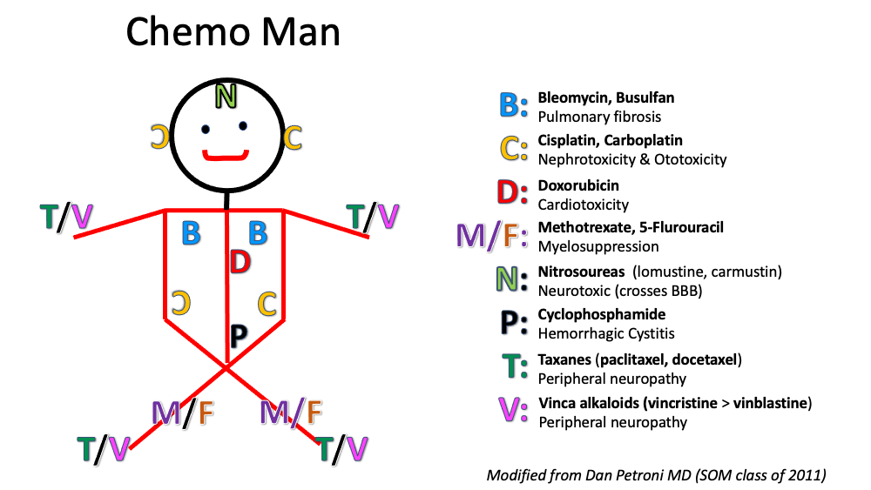

Slide 96
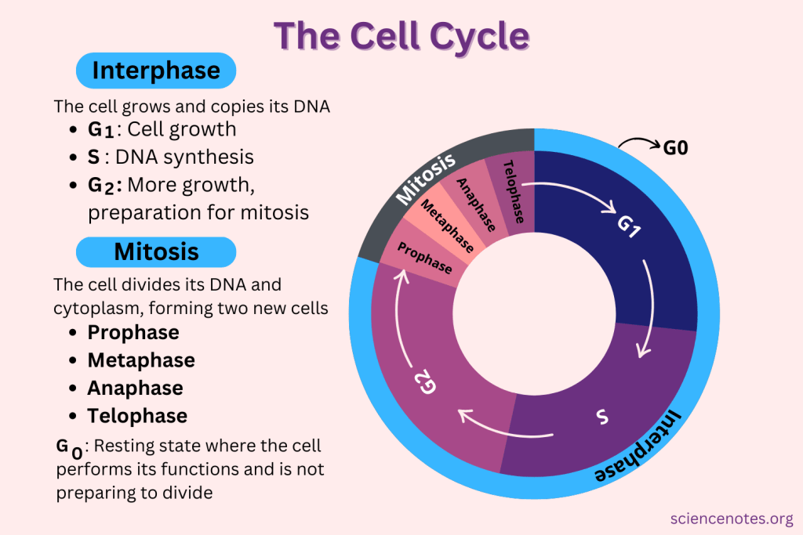

Slide 97
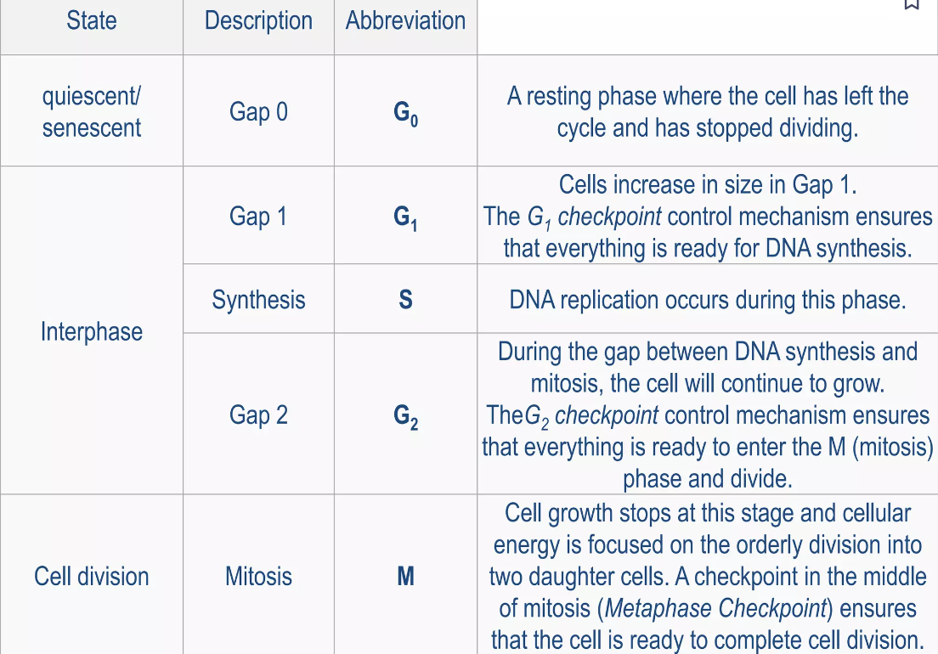

Slide 98
How chemotherapy works against cancer
Chemotherapy works by stopping or slowing the growth of cancer cells, which grow and divide quickly. Chemotherapy is used for two reasons:
Treat cancer: Chemotherapy can be used to cure cancer, lessen the chance it will return, or stop or slow its growth.
Ease cancer symptoms: Chemotherapy can be used to shrink tumors that are causing pain and other problems.
It targets cells that grow and divide quickly, as cancer cells do. Chemo can work throughout your body unlike radiation or surgery, which target specific areas. But it can also affect some fast-growing healthy cells, like those of the skin, hair, intestines, and bone marrow. That’s what causes some of the side effects from the treatment.

Slide 99
How chemotherapy works against cancer
Every time any new cell is formed, it goes through a usual process to become a fully functioning (or mature) cell. The process involves a series of phases and is called the cell cycle.
Cancer cells tend to form new cells more quickly than normal cells and this makes them a better target for chemotherapy drugs.
However, chemodrugs can’t tell the difference between healthy cells and cancer cells. This means normal cells are damaged along with the cancer cells, and this causes side effects.
The good news is that most normal cells will recover from the effects of chemo over time. But cancer cells are mutated (not normal) cells, and they usually do not recover from the effects of chemo. This is why chemo is good at killing many types of cancer cells.

Slide 100
NURSING IMPLICATIONS
IV route may be obtained by subclavian catheters, implanted ports, or peripherally inserted catheters.
Extravasation is the major complication of IV chemotherapy
WARNING: NEVER TEST VEIN PATENCY WITH CHEMOTHERAPEUTIC AGENTS.
Monitor the client closely for anaphylactic reactions or serious side effects. Discontinue infusion according to the protocol if a reaction occurs.
Use caution when preparing, administering, or disposing of chemotherapy agents.

Slide 101
Side effects of chemotherapy
Bone Marrow Suppression:
Leukopenia
  Avoid crowds, people with infections, and small children when the WBC count is low.
  Avoid undercooked meat and raw fruit and vegetables.

Slide 102
Side effects of chemotherapy
Bone Marrow Suppression:
Thrombocytopenia
  Use an electric razor when shaving.
  Avoid contact sports.
  If trauma occurs, apply an ice pack and seek medical assistance.
  Avoid dental work or other invasive procedures
  Avoid aspirin and aspirin-containing products.

Slide 103
Side effects of chemotherapy
Bone Marrow Suppression:
Anemia
Instruct the patient to avoid strenuous activities
Educate the patient that there’s a possibility of blood transfusion

Slide 104
Side effects of chemotherapy
Bone Marrow Suppression:
Anemia
  Instruct the patient to avoid strenuous activities
  Educate the patient that there’s a possibility of blood transfusion

Slide 105
Side effects of chemotherapy
GI effects:
Client Education
  Eat small, frequent, low-fat meal
  Avoid spicy and fatty foods
  Avoid extreme hot foods
  Administer antiemetics before chemotherapy
  Weigh clients routinely.

Slide 106
Side effects of chemotherapy
STOMATITIS AND MUCOSITOSIS
  Use a soft toothbrush. Mouth swabs may be needed during an acute episode.
  Avoid mouthwashes containing alcohol. Do not use lemon glycerin swabs or dental floss.
  Consider using chlorhexidine mouthwash to decrease the risk of hemorrhage and protect gums from trauma.

